Slide 1
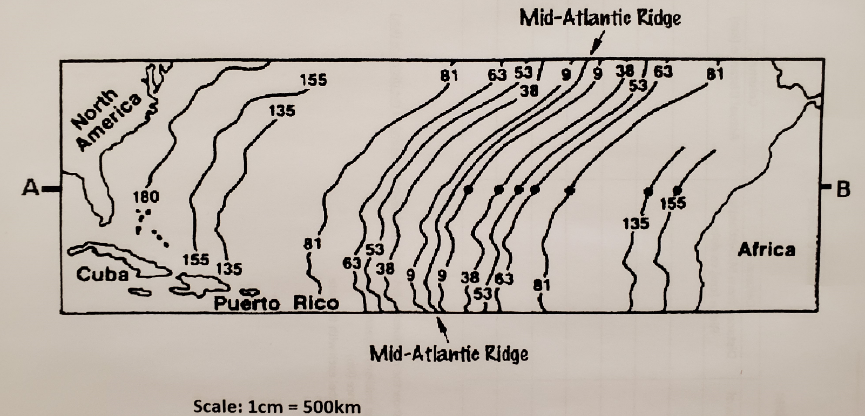
The diagram represents a section of the ocean floor in the North Atlantic.
1. Locate the Mid-Atlantic ridge and trace it in RED.
2. Lightly shade in the age bands as follows:
0 – 9 million years = white
9 – 38 million years = purple
38 – 63 million years = blue
63 – 81 million years = yellow
81 – 135 million years = green
135 – 180 million years = orange
3. Draw a line on the map from A to B with a RULER. This line represents a path across the Atlantic Ocean from North America to Africa.
4. Use a ruler to measure the distance in centimeters (cm), to the nearest tenth (0.1), from the mid-ocean ridge to each of the positions shown by a dot.
5. Record the measurements on the data table provided in the column titled “Distance from Mid-Atlantic ridge in cm” Column B.
6. Complete the rest of the data table by finding the actual distance in kilometers. (1 cm = 500 km).
Use the formula below to do this:
Actual distance (km) = Column B (cm) x 500 km/cm

Slide 2
DAY 2
Finish any work from yesterday that is not completed.
Complete the assessment calculation sheet using a calculator.
Be sure to follow the steps carefully to get the correct calculations
Show all the work for both steps to get credit – if the formula is not done out then you will not get credit
Make sure the sheet is complete and labeled before moving on to the graph
Graph Directions:
Graph the data in the chart to show the relationship between ages (millions of years) to the distance (km). Use graph paper and a ruler to complete your graph. Remember graphing rules.
Label the x-axis with age (millions of years)
Label the y-axis with distance (km)
Plot the data points and label each with the date
Draw a line of best fit.
When both tasks are complete then you are done for the day

Slide 3
DAY 3
Finish any work from yesterday that is not completed.
Assessment Questions -
Type the answers to the questions. Be sure you use complete sentences and be sure you answer all parts of the question. You must type the question and then answer it below.
Order to pass in your Lab/Activity
Your Data Table and Map
Your Graph
Your Calculation Assessment Sheet
Typed and Printed Assessment Questions
Staple together in correct order and make sure your is on the very first page

